Slide 1
Data Marsh Mallows
Real Time Network Voice Call Quality Data

Slide 2
Agenda
Overview of Dataset
EDA
Model - Random Forest n KNN
Evaluation
Conclusion

Slide 3


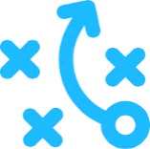
Dataset Overview | Network Voice Call Quality
Objectives
Network Performance Monitoring : Comparison of Expected Performance verse Actual Performance
Enables Network Operators to compare their performance in comparison and invest accordingly to improve their market share. This would enable a competitive and fair marketplace across India
Definition
This data captures the Customers Feedback using TRAI (Telecom regulatory authority of India) MyCAll App. Customers rates their experience about voice call quality in real time and help TRAI gather customer experience data along with Network data.
The data is captured for various service providers, at multiple locations, network types 3G, 4G, 2G, ratings, coordinates etc. The data attached is for two different months.
Measurements
Prediction of Voice Call Quality Category given the Operator, Network Type, and position of the customer

Slide 4
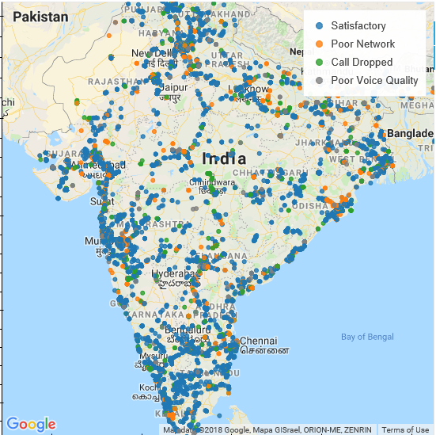
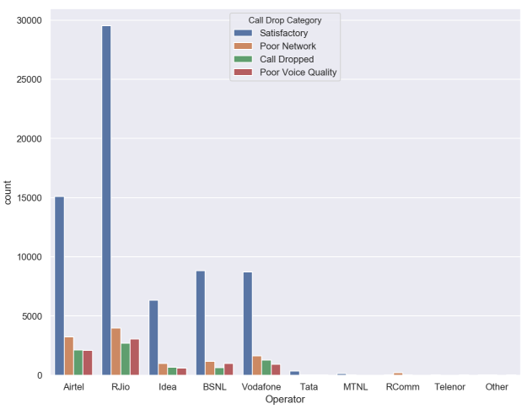
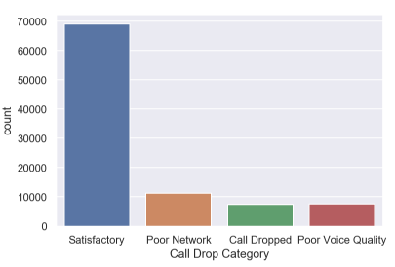
EDA

Slide 5
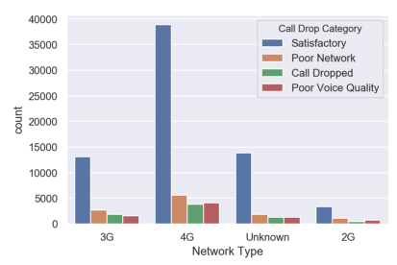
EDA

Slide 6
Model1 | Random Forest Tree
Model Accuracy
Signed off for FTTX
Model Categories used
Latitude and Longitude
Network Type
Coverage Type (Indoor/Outdoor)
Random Forest
Model Sumary
Provide E2E visibility of FTTx network. This network visibility will also be an enabler for improving and migration work required for Capacity Management will only implemented in Phase 3 of LNI

Slide 7
Model2 | KNN
Model Categories used
Latitude and Longitude
Network Type
Coverage Type (Indoor/Outdoor)
Model Accuracy
Signed off for FTTX
K Nearest Neighbour
Model Sumary
Provide E2E visibility of FTTx network. This network visibility will also be an enabler for improving and migration work required for Capacity Management will only implemented in Phase 3 of LNI

Slide 8
Evaluation And Conclusion
The dataset used was very unbalanced towards the satisfactory side of the network quality
Due to the imbalance our 2 models tends to predict good quality 92% accurately and bad/dropped calls 32% accurately

Slide 9
Thank you
.

